Slide 1
Cryptography: Modern Symmetric Ciphers
INFSCI 1075: Network Security – Spring 2013
Amir Masoumzadeh

Slide 2
Outline
Last Week
  Why encryption?
    Provides protection
    Security services - confidentiality, authentication, integrity, non-repudiation
  Cryptography
    Shift Cipher (e.g. Caesar or Affine Cipher)
    Substitution Cipher (e.g. Vigenère )
    Transposition / Permutation Cipher
    Product Cipher
This week
  Block vs. Stream Cipher
  Modern Conventional Encryption
    DES, AES

Slide 3
Block Ciphers
Encrypt data one block at a time
Each block of data is encrypted using the same key k
Plain text “blocks”: x₁, x₂, x₃, x₄, …
Ciphertext “blocks”: y₁, y₂, y₃, y₄, …
  y₁ = e_{k}(x₁); y₂ = e_{k}(x₂); y₃ = e_{k}(x₃); …
k is the same

Slide 4
Stream Ciphers
Each element, bit or byte is encrypted (e.g. Vigenère)
There is a corresponding key stream k₁, k₂, k₃,…
  Plain text: x₁, x₂, x₃, x₄, …
  Ciphertext: y₁, y₂, y₃, y₄, …
  Key stream: k₁, k₂, k₃, k₄, …
  y₁ = e_{k1}(x₁); y₂ = e_{k2}(x₂); y₃ = e_{k3}(x₃); …
The key stream should be generated in a secure manner from some secret k

Slide 5
Autokeyed Vigenere Cipher
Shift cipher with a key stream in Z₂₆
  Plaintext: x ∈{0,1,2, …,25}
  Ciphertext: y ∈{0,1,2, …,25}
  Main Key: k ∈{0,1,2, …,25}
  Encryption: e_{ki}(x_{i}) = x_{i} + k_{i} mod 26
  Decryption: d_{ki}(y_{i}) = y_{i} – k_{i} mod 26
Generation of the key stream k_{i} is simple
  Use a main key k for the first alphabet
  Reuse the plaintext as the key for the rest

Slide 6
Autokeyed Vigenere Cipher - Encryption
Plaintext is
  FLEE SPEEDILY = [5 11 4 4 18 15 4 4 3 8 11 24]
Key for generating the key stream is k = 5
Key stream is generated using the plaintext itself
  The previous plaintext is the key for the next one
Key stream is [5 5 11 4 4 18 15 4 4 3 8 11]
Ciphertext = [10 16 15 8 22 7 19 8 7 11 19 9]
Ciphertext in alphabet form – KQPIWHTIHLTJ
Errors can propagate in this case

Slide 7
Autokeyed Vigenere Cipher - Decryption
Cyphertext was KQPIWHTIHLTJ
Use the fact that the first key is k=5
  first alphabet is K: leads to 10 –5 = 5 = F
Alphabet
Ciphertext
Previous
Plaintext
Plaintext
2
Q = 16
5
16 – 5 = 11: L
3
P = 15
11
15 – 11 = 4: E
4
I = 8
4
8 – 4 = 4: E
5
W = 22
4
22 – 4 = 18: S
6
H = 7
18
7 – 18 = -11 = 26: P

Slide 8
Simple Binary Stream Cipher (XOR)‏
k_{i}
k_{i}
1 bit or
byte
1 bit or
byte
1 bit or
byte
x_{i}
y_{i}
x_{i}
Alice
XOR
XOR
Bob
Alice
Plaintext
1000001
ASCII ‘A’
Key stream
0101101
After XOR
Ciphertext
1101100
ASCII ‘l’
Bob
Ciphertext
1101100
ASCII ‘l’
Key stream
0101101
After XOR
Plaintext
1000001
ASCII ‘A’

Slide 9
Linear Feedback Shift Registers (LFSRs)
One method of generating the “key stream”
As the name implies, LFSRs are linear
  If you know the current state, you can predict the next state
  Linear properties make them easy to break given enough information (2*n plaintext – cipher text pairs)
Uses a simple XOR to generate key stream
  XOR the key stream with information to encrypt
Starts with a “seed” or Initial Vector (IV)
Have a finite number of states
  Eventually repeat
  Have a maximum period (or cycle) of 2^{n} – 1 where n is the number of “registers”
  Not all LFSRs have the maximum length

Slide 10
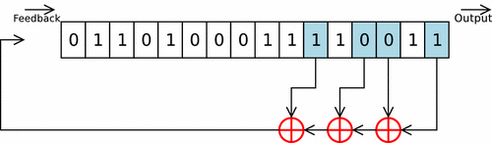
LFSR - Example

Slide 11
LFSR - Example
Output
Feedback
0
1
1
0
1
0
0
0
1
1
1
1
0
0
1
1
1
0
1
0
0
1
1
1
XOR
XOR
XOR
Output
Feedback
0
0
1
1
0
1
0
0
0
1
1
1
1
0
0
1
1
1
1
1
0
1
1
0
XOR
XOR
XOR

Slide 12
Modern Conventional Encryption
What do we need? (Review)
An encryption algorithm that either costs a lot to break or takes a lot of time to break
Computational security
  The cost of breaking the ciphertext exceeds the value of the encrypted information
  The time required to break the ciphertext exceeds the useful lifetime of the information

Slide 13
Goal of Modern Encryption Schemes
Oscar can recover the key to the encryption algorithm by brute force search alone and not by any shortcuts
The number of possible keys to be tested should be so large as to make brute force search infeasible
Example: Data Encryption Standard has 56 bit keys ➔ 2⁵⁶ possible keys = 7.2 x 10¹⁶ keys
  If each key attempt took 100ms, a worst case brute force attack would still take 228,493,131 years.

Slide 14
Modern Block Ciphers
One of the most widely used types of cryptographic algorithms
Provide secrecy/authentication services
Focus on DES (Data Encryption Standard) to illustrate block cipher design principles
Notes:
Modern block ciphers are widely used to provide encryption of quantities of information, and/or a cryptographic checksum to ensure the contents have not been altered. We continue to use block ciphers because they are comparatively fast, and because we know a fair amount about how to design them. Will use the widely known DES algorithm to illustrate some key block cipher design principles.

Slide 15
Requirements of Modern Block Ciphers
Reversible
  Each ciphertext block should correspond to a unique plaintext block
Non-linear
  Prevent linear analysis that was possible with LFSR
Key size
  Should be of the same order as the plaintext block
Efficient
  Easily implementable
  Fast encryption and decryption
Output should be as random as possible to prevent statistical analysis

Slide 16
Modern Block Ciphers
64-bit input
8bits
8bits
8bits
8bits
8bits
8bits
8bits
8bits
loop for
n rounds
T₁
T₂
T₃
T₄
T₅
T₆
T₇
T₈
8 bits
8 bits
8 bits
8 bits
8 bits
8 bits
8 bits
8 bits
64-bit scrambler
64-bit output
One pass through: one input bit affects eight output bits
Multiple passes: each input bit affects all output bits
Block ciphers: DES, 3DES, AES

Slide 17
Data Encryption Standard (DES)
Most widely used private key block cipher in the world
Adopted in 1977 by NBS (now NIST)
  as FIPS PUB 46
Encrypts 64-bit data using 56-bit key
Has been considerable controversy over its security
64
64
e
x_{i}
y_{i}
56
Notes:
The most widely used private key block cipher, is the Data Encryption Standard (DES). It was adopted in 1977 by the National Bureau of Standards as Federal Information Processing Standard 46 (FIPS PUB 46). DES encrypts data in 64-bit blocks using a 56-bit key. The DES enjoys widespread use. It has also been the subject of much controversy its security.

Slide 18
DES History
IBM developed Lucifer cipher
  by team led by Feistel in late 60’s
  used 64-bit data blocks with 128-bit key
Then redeveloped as a commercial cipher with input from NSA and others
In 1973 NBS issued request for proposals for a national cipher standard
IBM submitted their revised Lucifer which was eventually accepted as the DES
Notes:
In the late 1960s, IBM set up a research project in computer cryptography led by Horst Feistel. The project concluded in 1971 with the development of the LUCIFER algorithm. LUCIFER is a Feistel block cipher that operates on blocks of 64 bits, using a key size of 128 bits.
Because of the promising results produced by the LUCIFER project, IBM embarked on an effort, headed by Walter Tuchman and Carl Meyer, to develop a marketable commercial encryption product that ideally could be implemented on a single chip. It involved not only IBM researchers but also outside consultants and technical advice from NSA. The outcome of this effort was a refined version of LUCIFER that was more resistant to cryptanalysis but that had a reduced key size of 56 bits, to fit on a single chip.
In 1973, the National Bureau of Standards (NBS) issued a request for proposals for a national cipher standard. IBM submitted the modified LUCIFER. It was by far the best algorithm proposed and was adopted in 1977 as the Data Encryption Standard.

Slide 19
DES Design Controversy
Although DES standard is public
Was considerable controversy over design
  in choice of 56-bit key (vs Lucifer 128-bit)
  and because design criteria were classified! (Totally against Kerckhoff’s principle)
Subsequent events and public analysis show in fact design was appropriate
Use of DES has flourished
  especially in financial applications
  still standardized for legacy application use
Notes:
Before its adoption as a standard, the proposed DES was subjected to intense & continuing criticism over the size of its key & the classified design criteria.
Recent analysis has shown despite this controversy, that DES is well designed. DES is theoretically broken using Differential or Linear Cryptanalysis but in practise is unlikely to be a problem yet. Also rapid advances in computing speed though have rendered the 56 bit key susceptible to exhaustive key search, as predicted by Diffie & Hellman.
DES has flourished and is widely used, especially in financial applications. It is still standardized for legacy systems, with either AES or triple DES for new applications.

Slide 20
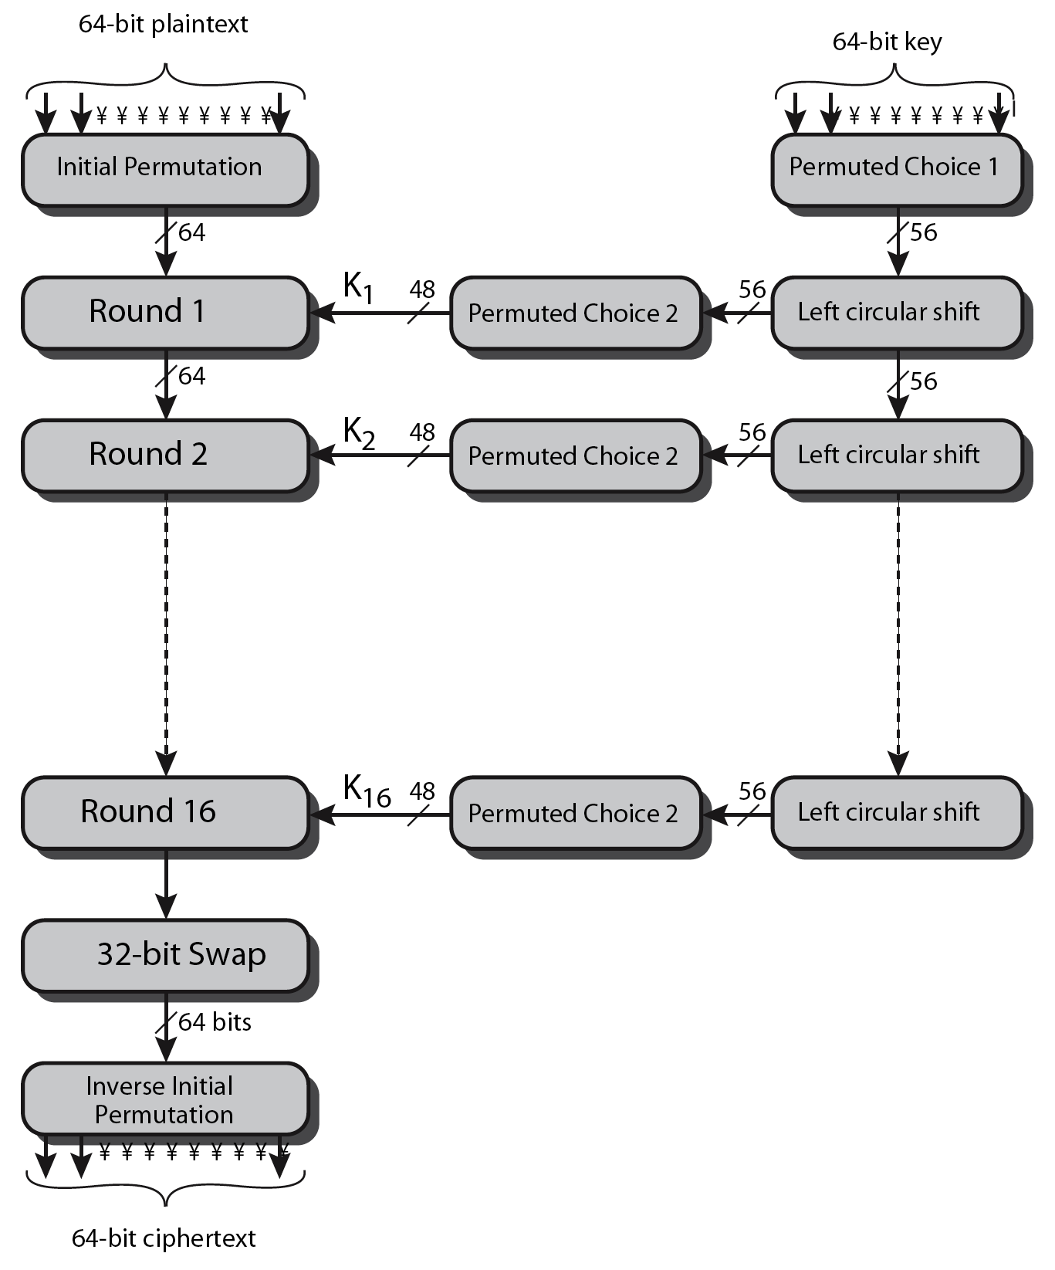
DES Encryption Overview
Notes:
The overall scheme for DES encryption is illustrated in Stallings Figure3.4, which takes as input 64-bits of data and of key.
The left side shows the basic process for enciphering a 64-bit data block which consists of:
- an initial permutation (IP) which shuffles the 64-bit input block
- 16 rounds of a complex key dependent round function involving substitutions & permutations
- a final permutation, being the inverse of IP
The right side shows the handling of the 56-bit key and consists of:
- an initial permutation of the key (PC1) which selects 56-bits out of the 64-bits input, in two 28-bit halves
- 16 stages to generate the 48-bit subkeys using a left circular shift and a permutation of the two 28-bit halves

Slide 21
DES Encryption Overview
x
64
Initial Permutation
Key
Schedule
64
k₁
64
Round 1
48
32 Bit Swap
64
56
k₂
k
64
Round 2
…
48
Inverse
Initial Permutation
64
64
Round 16
k₁₆
y
48

Slide 22
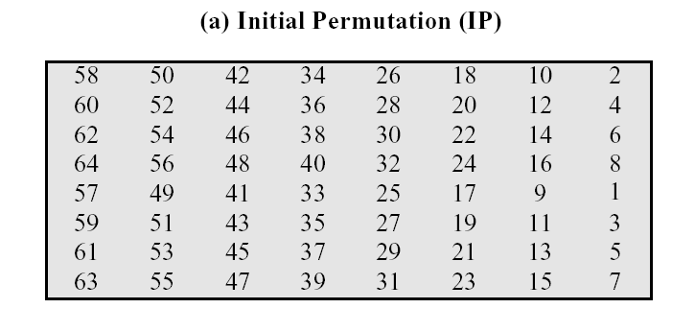
Initial Permutation (IP)
First step of the data computation
IP reorders the input data bits
  Even bits to LH half, odd bits to RH half
Example: IP(675a6967 5e5a6b5a) = ?
IP Table interpretation
  Bit 58 will be the 1st bit, bit 50 will be the 2nd bit, etc.
Notes:
The initial permutation and its inverse are defined by tables, as shown in Stallings Tables 3.2a and 3.2b, respectively. The tables are to be interpreted as follows. The input to a table consists of 64 bits numbered left to right from 1 to 64. The 64 entries in the permutation table contain a permutation of the numbers from 1 to 64. Each entry in the permutation table indicates the position of a numbered input bit in the output, which also consists of 64 bits.
Note that the bit numbering for DES reflects IBM mainframe practice, and is the opposite of what we now mostly use - so be careful! Numbers from Bit 1 (leftmost, most significant) to bit 32/48/64 etc (rightmost, least significant).
Note that examples are specified using hexadecimal.
Here a 64-bit plaintext value of “675a6967 5e5a6b5a” (written in left & right halves) after permuting with IP becomes “ffb2194d 004df6fb”.

Slide 23
Initial Permutation (IP)
Example:
IP(675a6967 5e5a6b5a) = ??
1 5 9 13 17 21 25 29 33 37 41 45 49 53 57 64
0110 0111 0101 1010 0110 1001 0110 0111 0101 1110 0101 1010 0110 1011 0101 1010
IP(675a6967 5e5a6b5a) = (ffb2194d 004df6fb)
Notes:
The initial permutation and its inverse are defined by tables, as shown in Stallings Tables 3.2a and 3.2b, respectively. The tables are to be interpreted as follows. The input to a table consists of 64 bits numbered left to right from 1 to 64. The 64 entries in the permutation table contain a permutation of the numbers from 1 to 64. Each entry in the permutation table indicates the position of a numbered input bit in the output, which also consists of 64 bits.
Note that the bit numbering for DES reflects IBM mainframe practice, and is the opposite of what we now mostly use - so be careful! Numbers from Bit 1 (leftmost, most significant) to bit 32/48/64 etc (rightmost, least significant).
Note that examples are specified using hexadecimal.
Here a 64-bit plaintext value of “675a6967 5e5a6b5a” (written in left & right halves) after permuting with IP becomes “ffb2194d 004df6fb”.

Slide 24
Initial Permutation (IP) and Its Inverse
1
2
22
50
58
64
Initial Permutation (IP)‏
1
2
22
25
40
64
1
2
22
25
40
64
Inverse Initial
Permutation (IP⁻¹)‏
1
2
22
50
58
64

Slide 25
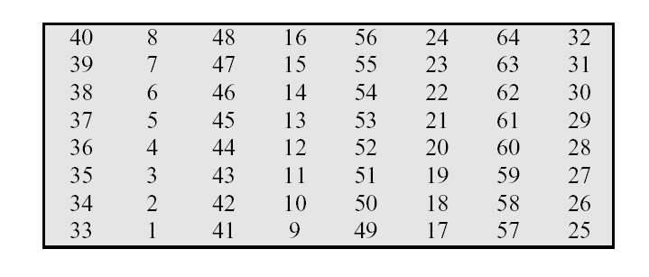
Tables for IP and IP⁻¹
Initial Permutation
Inverse of Initial Permutation

Slide 26
A Round of DES
L_{i-1}^{e}
R_{i-1}^{e}
Feistel
Structure
f
k_{i}
L_{i}^{e}
R_{i}^{e}
L_{i}^{e} = R_{i-1}^{e}
R_{i}^{e} = L_{i-1}^{e} ⊕[f(R_{i-1}^{e}, k_{i})]

Slide 27
The function “f ”
32
R_{i-1}^{e}
Expansion
Permutation
48
E(R_{i-1}^{e})‏
48
k_{i}
E(R_{i-1}^{e}) ⊕ k_{i}
48
1 6 7 12 13 18 48
Substitution
Boxes
B₁
B₂
B₃
B₄
B₅
B₆
B₇
B₈
32
6
6
6
6
6
6
6
6
S₁
S₂
S₃
S₄
S₅
S₆
S₇
S₈
Permutation P
32
4
4
4
4
4
4
4
4

Slide 28
DES Decryption
Decryption must unwind steps of data encryption
With Feistel design,
    Basically, you need to do encryption steps once more using sub keys in reverse order (K₁₆ , K₁₅ , … , K₁)
Notes:
As with any Feistel cipher, DES decryption uses the same algorithm as encryption except that the subkeys are used in reverse order SK16 .. SK1.
If you trace through the DES overview diagram can see how each decryption step top to bottom with reversed subkeys, undoes the equivalent encryption step moving from bottom to top.

Slide 29
Avalanche Effect
A desirable property of any encryption algorithm
A change of one input bit or key bit should result in changing approx half of output bits!
Making attempts to guess the key by using different Plaintext – Ciphertext pairs should be impossible
DES exhibits strong avalanche (Strong advantage)
Notes:
A desirable property of any encryption algorithm is that a small change in either the plaintext or the key should produce a significant change in the ciphertext. In particular, a change in one bit of the plaintext or one bit of the key should produce a change in many bits of the ciphertext. If the change were small, this might provide a way to reduce the size of the plaintext or key space to be searched. DES exhibits a strong avalanche effect, as may be seen in Stallings Table 3.5.

Slide 30
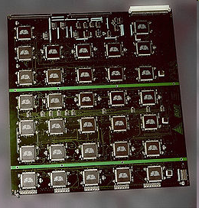
Actual Cases of Breaking DES
Electronic Frontier Foundation spent $220,000 to crack DES in 3 days using 1500 chips (July 1998)
  Searched 90 billion keys per second
22 ½ hours in March 1999 (plaintext was “See you in Rome”) @ $250,000 and a distributed effort

Slide 31
Strength of DES
Time to break DES
  Number of keys: 2⁵⁶ = 7.2 x 10¹⁶ keys
    On the average you need to search through 2⁵⁵ keys (half of all possible keys must be tried to achieve success.)
    In the worst case you need to search all 2⁵⁶ keys
  If you can do one encryption/decryption in 1 clock cycle @ 500 MHz
    Time taken to check ONE key = 1/(500 x 10⁶) s
    Time taken to check 2⁵⁵ keys = 2⁵⁵/(500 x 10⁶) s = 72,057,594.04 s /3600 = 20016 hours /24 = 834 days
The hertz (symbol: Hz) is defined as the number of cycles per second (MHz = 10⁶ Hz )
Cost to break DES
  At $20 a chip, to break DES in one day, you need to spend $16,680

Slide 32
Example
Assume that you have a PC that can do 10⁶ decryption per µs. You want to decrypt an algorithm that its key space/key size has 56 bits using brute force approach. So you need to in average check half of the key space. How long does it take to check half of the key space using your PC? (µs = 10⁻⁶ seconds)
2⁵⁶ / 2 = 2⁵⁵ different keys to be checked (should be decrypted)
In each µs you can decrypt 10⁶ ciphertexts using 10⁶ keys out of 2⁵⁵
How many µs to decrypt using 2⁵⁵ keys?
  2⁵⁵ / 10⁶ = 36028797018.963968 µs = 36028797018.963968 *10⁻⁶ ~ 36029 sec
  36029 sec / 60 ~ 600 min
  600 min / 60 ~ 10 hours

Slide 33
Key Size (bits) | Number of Alternative Keys | Time required at 1 decryption/µs | Time required at 10⁶ decryptions/µs
32 | 2³² = 4.3 × 10⁹ | 2³¹ µs = 35.8 minutes | 2.15 milliseconds
56 | 2⁵⁶ = 7.2 × 10¹⁶ | 2⁵⁵ µs = 1142 years | 10.01 hours
128 | 2¹²⁸ = 3.4 × 10³⁸ | 2¹²⁷ µs = 5.4 × 10²⁴ years | 5.4 × 10¹⁸ years
168 | 2¹⁶⁸ = 3.7 × 10⁵⁰ | 2¹⁶⁷ µs = 5.9 × 10³⁶ years | 5.9 × 10³⁰ years
26 characters (permutation) | 26! = 4 × 10²⁶ | 2 × 10²⁶ µs = 6.4 × 10¹² years | 6.4 × 10⁶ years

Slide 34
Strength of DES (2)
Weak Keys
  Symmetry of bits in the 32 bit halves makes the key weak
  Roughly 64 weak keys, e.g.:
    Alternating ones + zeros (0x0101010101010101)
    Alternating 'F' + 'E' (0xFEFEFEFEFEFEFEFE)
    '0xE0E0E0E0F1F1F1F1' or '0x1F1F1F1F0E0E0E0E'
Number of rounds
  Six round DES was broken very early on
  Less than 16 rounds makes DES less secure

Slide 35
Strength of DES (3)
Complement keys
  If you replace zeros by ones and ones by zeros, it is called complementing
If you have the complement of a key, it will encrypt the complement of a plaintext into the complement of the ciphertext
  Y=DES(X, K) implies that Y'=DES(X', K') where X' is the bit by bit complementation of X

Slide 36
Strength of DES (3)
This Reduces key search by half for a “chosen plaintext” attack (How?)
  Let’s say you have a Plaintext-Ciphertext pair (P, C) for which you want to find the key K
  You try encrypting P using key K: Y=DES(P, K)
  If the key K faild (Y≠ C), you can use the complementation property (Y'=DES(P', K') ) to evaluate K' by checking if Y' is equal to C'
  Therefore you are evaluating two keys (K, K') by only running DES with one key (K), and therefore reduce the number of keys that need to be tried by a factor of 2 from 2⁵⁵ to 2⁵⁴
  See Problem 3.13 in the text book

Slide 37
Block Cipher Design
Basic principles still like Feistel’s in 1970’s
Number of rounds
  more is better, exhaustive search will be the best attack then
Function f
  Provides “confusion”, nonlinearity, avalanche
    Confusion: Obscures the relationship between the plaintext and ciphertext
key schedule
  Complex sub key creation, goal is to have key avalanche
Notes:
The cryptographic strength of a Feistel cipher derives from three aspects of the design: the number of rounds, the function F, and the key schedule algorithm. Briefly discuss these.
The greater the number of rounds, the more difficult it is to perform cryptanalysis, even for a relatively weak F. In general, the criterion should be that the number of rounds is chosen so that known cryptanalytic efforts require greater effort than a simple brute-force key search attack. This criterion is attractive because it makes it easy to judge the strength of an algorithm and to compare different algorithms.
The function F provides the element of confusion in a Feistel cipher, want it to be difficult to “unscramble” the substitution performed by F. One obvious criterion is that F be nonlinear. The more nonlinear F, the more difficult any type of cryptanalysis will be. We would like it to have good avalanche properties, or even the strict avalanche criterion (SAC). Another criterion is the bit independence criterion (BIC). One of the most intense areas of research in the field of symmetric block ciphers is that of S-box design. Would like any change to the input vector to an S-box to result in random-looking changes to the output. The relationship should be nonlinear and difficult to approximate with linear functions.
A final area of block cipher design, and one that has received less attention than S-box design, is the key schedule algorithm. With any Feistel block cipher, the key schedule is used to generate a subkey for each round. Would like to select subkeys to maximize the difficulty of deducing individual subkeys and the difficulty of working back to the main key. The key schedule should guarantee key/ciphertext Strict Avalanche Criterion and Bit Independence Criterion.

Slide 38
Other Block Ciphers
DES is weak because of the key space
  Brute force attacks are possible
  Today, you need a cipher with at least a key that is 80 bits long
Alternatives are being used in applications today
  IDEA – International Data Encryption Algorithm by James Massey and Xuejia Lai (1990-92)
    Block size of 64 bits and key size of 128 bits
    Non-Feistel
    Included in Pretty Good Privacy (PGP)
  CAST-128
    Feistel (Block size of 64 bits and key size of 128 bits)
  Blowfish
    64 bit blocks, variable key sizes
  AES

Slide 39
Double Encryption
Consider double encryption with the shift or affine cipher
  Is it useful?
  Do we get any additional security?
  Why? Why not?
Intermediate
Ciphertext
Plaintext
Ciphertext
e
e
x
z
y
k₁
k₂

Slide 40
Triple DES
While Advanced Encryption Standard (AES) was being developed, triple DES was used as the de-facto standard
What is triple-DES?
We shall first look at double DES and the meet-in-the-middle attack

Slide 41
Double DES
64
64
64
e
e
x
z
y
k₁
56
k₂
56
Question: Does there exist a key k₃ such that e_{k3}(x) = y in the case of DES?
  If yes, any number of stages of DES will be useless
  Note that DES itself is a product cipher of the elementary “round” cipher
  Fortunately, the answer is no, so that we can use multiple stages of DES to provide increased security

Slide 42
Meet In The Middle Attack
y = e_{k2}(e_{k1}(x)) ➔ 2⁵⁶ x 2⁵⁶ = 2¹¹² possible keys
However: z = e_{k1}(x) and z = d_{k2}(y)
Key k
e_{k} (x)
Known Plaintext-Ciphertext Attack
For each k^{(i)}, i = 1,2,3,…,2⁵⁶
Check if d_{k(i)}(y) = any of z^{(i)}
k⁽¹⁾
z⁽¹⁾
k⁽²⁾
z⁽²⁾
k⁽³⁾
z⁽³⁾
k^{(i)}
z^{(i)}
Worst case effort is
2⁵⁶ + 2⁵⁶ = 2⁵⁷ keys
k^{(2^56)}
z^{(2^56)}

Slide 43
Meet In The Middle Attack
Assume you have a known plaintext-ciphertext pair
  1- For each key k(1), k(2), …, k(2⁵⁶) compute the encrypted value z(1), z(2), …, z(2⁵⁶)
  2- Store the results in a table
  3- Sort the table according to z(.). Why?
  4- Decrypt y using the keys k(1), k(2), …, k(2⁵⁶)
    After each decryption, check to see if the decrypted value is in the table
The two keys k₁ and k₂ can be recovered with high probability

Slide 44
Triple DES
64
64
64
64
e
e
e
x
z
w
y
k₁
56
k₂
56
k₃
56
y = e_{k3}( e_{k2}( e_{k1}(x) ) )
Meet in the middle attack is still possible but we now need ~2¹¹² operations
The best attack against triple-DES needs 2¹⁰⁸ operations
  http://citeseerx.ist.psu.edu/viewdoc/summary?doi=10.1.1.41.5608
Triple DES is three times slower than DES

Slide 45
Alternative form of Triple-DES
64
64
64
64
e
d
e
x
z
w
y
k₁
56
k₂
56
k₁
56
y = e_{k1}( d_{k2}( e_{k1}(x) ) )
Store lesser number of bits for keys (112 instead of 168)

Slide 46
Advanced Encryption Standard (AES)
Clear replacement for DES was needed
  had theoretical attacks that could break it
  have demonstrated exhaustive key search attacks
Can use Triple-DES – but slow, has small blocks
US NIST issued call for ciphers in 1997
15 candidates accepted in Jun 98
5 were shortlisted in Aug-99
Rijndael was selected as the AES in Oct-2000
Issued as FIPS PUB 197 standard in Nov-2001
Notes:
The Advanced Encryption Standard (AES) was published by NIST (National Institute of Standards and Technology) in 2001. AES is a symmetric block cipher that is intended to replace DES as the approved standard for a wide range of applications. The AES cipher (& other candidates) form the latest generation of block ciphers, and now we see a significant increase in the block size - from the old standard of 64-bits up to 128-bits; and keys from 128 to 256-bits. In part this has been driven by the public demonstrations of exhaustive key searches of DES. Whilst triple-DES is regarded as secure and well understood, it is slow, especially in s/w. In a first round of evaluation, 15 proposed algorithms were accepted. A second round narrowed the field to 5 algorithms. NIST completed its evaluation process and published a final standard (FIPS PUB 197) in November of 2001. NIST selected Rijndael as the proposed AES algorithm. The two researchers who developed and submitted Rijndael for the AES are both cryptographers from Belgium: Dr. Joan Daemen and Dr.Vincent Rijmen.

Slide 47
AES Requirements
Private key symmetric block cipher
128-bit data, 128/192/256-bit keys
Stronger & faster than Triple-DES
Active life of 20-30 years
Provide full specification & design details
Both C & Java implementations
NIST have released all submissions & unclassified analyses
Notes:
Listed above are NIST’s requirements for the AES candidate submissions. These criteria span the range of concerns for the practical application of modern symmetric block ciphers.

Slide 48
Rijndael Summary
Features
  Block lengths
    128/192/256 bits
  Key sizes
    128/192/256 bits
  Number of rounds corresponding to key size
    10/12/14
For larger block lengths, the number of rounds must be increased
  This makes any other attack as hard as brute force
128
128
e
x
y
k
128/192/256

Slide 49
AES Basics
AES is based on Rijndael
  The block length is fixed at 128 bits
No Feistel structure => all 128 bits of a round are encrypted in that round
  Smaller number of rounds compared to DES
Parameters
  Key size: N_{k} in 32-bit words
    Example: 128 bit key => Four 32-bit words => N_{k} = 4
  Block size: N_{b} in 32 bit words
  Number of rounds: N_{r}
    Rijndael specifies N_{r} = 6 + max(N_{k}, N_{b})

Slide 50
Evaluation Criteria
Security
  Resistance to cryptanalysis
  Mathematical foundation
  Randomness of output bits
  Relative security compared to competitors
Cost
  Royalty and intellectual property
  Platform dependence (8 bit to 256 bit architectures)
  Speed
  Efficiency
  Memory requirements

Slide 51
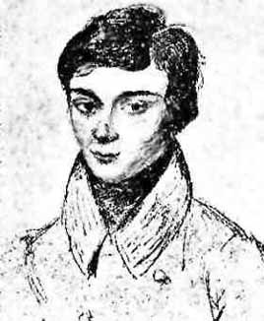
Underpinnings of AES
What are the underpinnings of AES?
  Abstract algebra and number theory
  Galois Fields (pronounced Gal-wa fields)
Evariste Galois
  1811-1832
  Died in a duel at the age of 20
Public key algorithms are also based on “fields” that are extensions of “rings”
  We need some more results from number theory to understand how public key algorithms work ☹
  Take graduate level “crypto” course

Slide 52
Stream Ciphers
Process message bit by bit (as a stream)
Have a pseudo random keystream
Combined (XOR) with plaintext bit by bit
Randomness of stream key completely destroys statistical properties in message
  C_{i} = M_{i} XOR StreamKey_{i}
But must never reuse stream key
  Otherwise can recover messages (e.g., book cipher)
Notes:
A typical stream cipher encrypts plaintext one byte (or bit) at a time, usually by XOR’ing with a pseudo-random keystream. The stream cipher is similar to the one-time pad discussed in Chapter 2. The difference is that a one-time pad uses a genuine random number stream, whereas a stream cipher uses a pseudorandom number stream. But rely on the randomness of stream key completely destroys statistically properties in message. However, you must never reuse a stream key since otherwise you can recover messages (as with a book cipher).

Slide 53
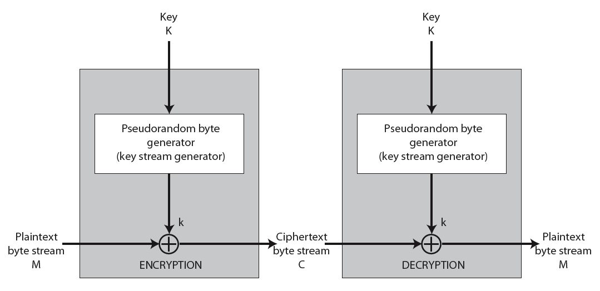
Stream Cipher Structure

Slide 54
Stream Cipher Properties
Some design considerations are:
  Long period with no repetitions
  Statistically random
  Depends on large enough key
  Large linear complexity
Properly designed, can be as secure as a block cipher with same size key
But usually simpler & faster
Notes:
[KUMA97] lists the following important design considerations for a stream cipher:
The encryption sequence should have a large period, the longer the period of repeat the more difficult it will be to do cryptanalysis.
The keystream should approximate the properties of a true random number stream as close as possible, the more random-appearing the keystream is, the more randomized the ciphertext is, making cryptanalysis more difficult.
To guard against brute-force attacks, the key needs to be sufficiently long. The same considerations as apply for block ciphers are valid here .Thus, with current technology, a key length of at least 128 bits is desirable.
With a properly designed pseudorandom number generator, a stream cipher can be as secure as block cipher of comparable key length. The primary advantage of a stream cipher is that stream ciphers are almost always faster and use far less code than do block ciphers.

Slide 55
RC4
A proprietary cipher owned by RSA DSI
Another Ron Rivest design, simple but effective
Variable key size, byte-oriented stream cipher
Widely used (web SSL/TLS, wireless WEP)
Key forms random permutation of all 8-bit values
Uses that permutation to scramble input info processed a byte at a time
Notes:
RC4 is a stream cipher designed in 1987 by Ron Rivest for RSA Security. It is a variable key-size stream cipher with byte-oriented operations. The algorithm is based on the use of a random permutation. Analysis shows that the period of the cipher is overwhelmingly likely to be greater than 10^100. Eight to sixteen machine operations are required per output byte, and the cipher can be expected to run very quickly in software. RC4 is probably the most widely used stream cipher. It is used in the SSL/TLS secure web protocol, & in the WEP & WPA wireless LAN security protocols. RC4 was kept as a trade secret by RSA Security, but in September 1994 was anonymously posted on the Internet on the Cypherpunks anonymous remailers list. In brief, the RC4 key is used to form a random permutation of all 8-bit values, it then uses that permutation to scramble input info processed a byte at a time.

Slide 56
RC4 Key Schedule
starts with an array S of numbers: 0..255
use key to well and truly shuffle
S forms internal state of the cipher
  for i = 0 to 255 do
    S[i] = i
    T[i] = K[i mod keylen])
  j = 0
  for i = 0 to 255 do
    j = (j + S[i] + T[i]) (mod 256)
    swap (S[i], S[j])
Notes:
The RC4 key schedule initialises the state S to the numbers 0..255, and then walks through each entry in turn, using its current value plus the next byte of key to pick another entry in the array, and swaps their values over. After doing this 256 times, the result is a well and truly shuffled array. The total number of possible states is 256! - a truly enormous number, much larger even than the 2048-bit (256*8) max key allowed can select.

Slide 57
RC4 Encryption
encryption continues shuffling array values
sum of shuffled pair selects "stream key" value from permutation
XOR S[t] with next byte of message to en/decrypt
  i = j = 0
  for each message byte M_{i}
    i = (i + 1) (mod 256)
    j = (j + S[i]) (mod 256)
    swap(S[i], S[j])
    t = (S[i] + S[j]) (mod 256)
    C_{i} = M_{i} XOR S[t]
Notes:
To form the stream key for en/decryption (which are identical), RC4 continues to shuffle the permutation array S by continuing to swap each element in turn with some other entry, and using the sum of these two entry values to select another value from the permutation to use as the stream key, which is then XOR’d with the current message byte.

Slide 58
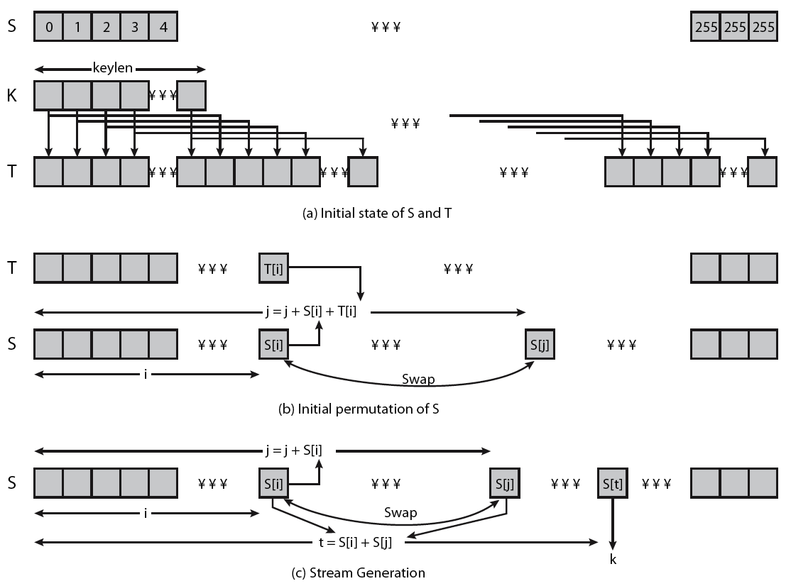
RC4 Overview

Slide 59
RC4 Security
Claimed secure against known attacks
  Have some analyses, none practical
Result is very non-linear
Since RC4 is a stream cipher, must never reuse a key
Have a concern with WEP, but due to key handling rather than RC4 itself
Notes:
A number of papers have been published analyzing methods of attacking RC4, but none of these approaches is practical against RC4 with a reasonable key length, such as 128 bits.
A more serious problem occurs in its use in the WEP protocol, not with RC4 itself but the way in which keys are generated for use as input to RC4.
Currently RC4 its regarded as quite secure, if used correctly, with a sufficiently large key.

Slide 60
Preparing for Midterm Exam
The exam will cover all the materials covered in the lectures till the end of Lecture 8
Regarding book chapters
  Make sure you have read (or at least carefully skimmed through) the related book chapters
  If we have not talked about a concept in the class at all, I will not expect you to know it
  Check out the exercises at the end of the chapters

